Slide 1

Class

Slide 2
Problem
Invoice
- taxType : int
+ setTaxType (t:int)
…
+ getTotal(amt) {a}
taxtType= t
——
——
——
switch(taxType)
{
case 1 :
——
case 2:
—-
}
——

Slide 3
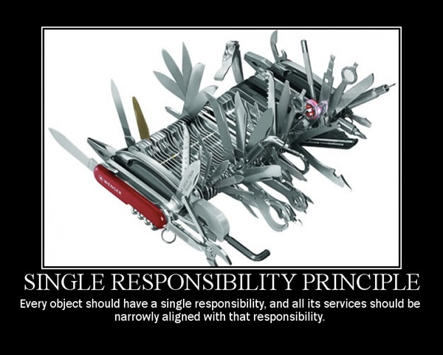

Slide 4
Problem
Invoice
TaxHelper
- taxType : int
+ setTaxType (t:int)
…
+ getTotal(amt) {a}
taxtType= t
+ get(amount,taxType)
switch(taxType)
{
case 1 :
——
case 2:
—-
}
——
——
——
taxAmount = TaxHelper.get(amount,taxType);
——

Slide 5
class Invoice
{
double getTotal()
{
…
tax = Tax.compute(total);
…
}
}
class Tax
{
static double compute(double amount) {}
}
Notes:
11. Using default constructor to initialize member variables

Slide 6

Static Methods

Slide 7
static methods cannot be overridden or extended through inheritance.

Slide 8
Abandon Static Methods
class Invoice
{
double getTotal(ITax tax)
{
…
taxAmount = tax.compute(total);
…
}
}
class Tax implements ITax
{
double compute(double amount) {}
}

Slide 9
Invoice
<<Tax>>
- taxType : Tax
get
+ setTaxType (t:Tax)
…
+ getTotal(amt) {a}
taxtType= t
KST
CST
get
get
——
——
——
taxAmount = taxType.get(amount);
——

Slide 10
Dependency is one of the most critical problems in software development. Much legacy code work involves breaking dependencies so that change can be easier.

Slide 11
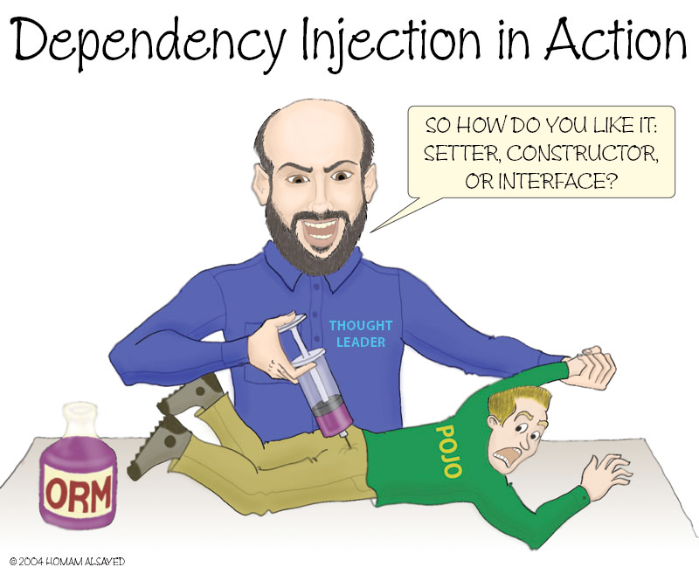

Slide 12
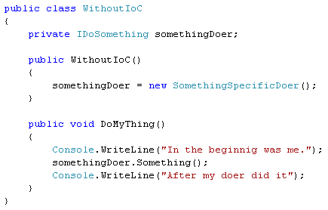
Concrete Class Dependency

Slide 13
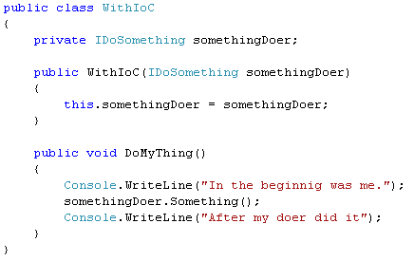
Allow dependency to be passed in

Slide 14
Invoice
<<Tax>>
- taxType : Tax
get
+ setTaxType (t:int)
…
+ getTotal(amt) {a}
public class InvoiceTest
{
@Test
public void createInvoiceTest(){
Invoice inv = new Invoice();
inv.setTax(new StubTax());
——
double total = invoice.getTotal();
assertTrue( total, 5667.78 );
}
}
StubTax
get

Slide 15
public class InvoiceTest
{
@Mock
private Tax tax;
private Invoice invoice;
@Before
public void setUp() throws Exception{
MockitoAnnotations.initMocks( this );
invoice = new Invoice( tax );
}
@Test
public void createInvoiceTest(){
when( tax.get(345.45) ).thenReturn( 23.67 );
——
double total = invoice.getTotal();
assertTrue( total, 5667.78 );
verify( tax).get(345.45);
}
}

Slide 16
Dialog
t1 : TextBox
t2 : TextBox
t3 : TextBox
b1 : Button
Init()
b1_Onclick()
int i = int.parse(t1.getText());
int j = int.parse(t2.getText());
Math obj = new Math();
int k = obj.add(10,20);
t3.setText(k.toString());

Slide 17

Minimize Untestable Code
GUI components
Multithreaded code
We can refactor the untestable code to improve its testability by moving the logic we want to test out of the class that is causing the lack of testability.
Notes:
Some kinds of code are diffi cult to test using Fully Automated Tests. GUI components,
multithreaded code, and Test Methods immediately spring to mind as
“untestable” code. All of these kinds of code share the same problem: They are
embedded in a context that makes it hard to instantiate or interact with them
from automated tests.
Untestable code simply won’t have any Fully Automated Tests to protect it
from those nefarious little bugs that can creep into code when we aren’t looking.
That makes it more diffi cult to refactor this code safely and more dangerous
to modify existing functionality or introduce new functionality.
It is highly desirable to minimize the amount of untestable code that we have
to maintain. We can refactor the untestable code to improve its testability by
moving the logic we want to test out of the class that is causing the lack of testability.
For active objects and multithreaded code, we can refactor to Humble
Executable (see Humble Object on page 695). For user interface objects, we
can refactor to Humble Dialog (see Humble Object). Even Test Methods can
have much of their untestable code extracted into Test Utility Methods, which
can then be tested.
When we Minimize Untestable Code, we improve the overall test coverage of
our code. In so doing, we also improve our confi dence in the code and extend
our ability to refactor at will. The fact that this technique improves the quality
of the code is yet another benefi t.

Slide 18
<<View>>
getText1() :String
getText2() :String
setText(val:String)
Dialog
View
t1 : TextBox
t2 : TextBox
t3 : TextBox
b1 : Button
Init()
getText1() :String
getText2() :String
setText(val:String) b1_Onclick()
int i = int.parse(t1.getText());
int j = int.parse(t2.getText());
Math obj = new Math();
int k = obj.add(10,20);
t3.setText(k.toString());

Slide 19
<<View>>
getText1() :String
getText2() :String
setText(val:String)
Dialog
Controller
View
t1 : TextBox
t2 : TextBox
t3 : TextBox
b1 : Button
controller : Controller
+ Controller(view: View)
onAdd()
+ Dialog()
Init()
getText1() :String
getText2() :String
setText(val:String) b1_Onclick()
controller = new Controller(this);
int i = int.parse(view.getText());
int j = int.parse(view.getText());
Math obj = new Math();
int k = obj.add(10,20);
view.setText(k.toString());
controller.onAdd()

Slide 20
public class DialogTest
{
@Mock
private View view;
@Before
public void setUp() throws Exception{
MockitoAnnotations.initMocks( this );
}
@Test
public void createInvoiceTest(){
when( view.getText1() ).thenReturn( “1000” );
when( view.getText2() ).thenReturn( “2000” );
Controller c = new Controller(view);
view.OnAdd();
verify( view).setText(“3000”);
}
}

Slide 21


The Newspaper Metaphor
Classes
A newspaper article:
At the top: the headline.
The 1st paragraph: a synopsis.
Then, as you read on, the details increase, until you have all the dates, names, etc.
A class:
At the top: the class name,
then the public method(s),
which call private functions defined bellow,
which in turn call other private functions that operate on a lower level, and so on…
Don't make your reader look UP !

Slide 22
public class RuntimeDAO {
private List<String> documentTypeIds;
public RuntimeDAO() {
documentTypeIds = new ArrayList<>();
}
}
Notes:
11. Using default constructor to initialize member variables

Slide 23
Use default constructor only when required
public class RuntimeDAO {
private List<String> documentTypeIds
= new ArrayList<>();
}

Slide 24
class CurrentAccount
{
void withDraw(double amount)
{
if(amount > 5000)
{
…
}
else
throw new NoSufficientFundsException();
}
}
class PlatinumAccount extends CurrentAccount
{
void withDraw(double amount)
{
if(amount > 100000)
{
…
}
else
throw new NoSufficientFundsException();
}
}

Slide 25
void doJob( CurrentAccount a)
{
…
a.withDraw(7000);
…
}

Slide 26
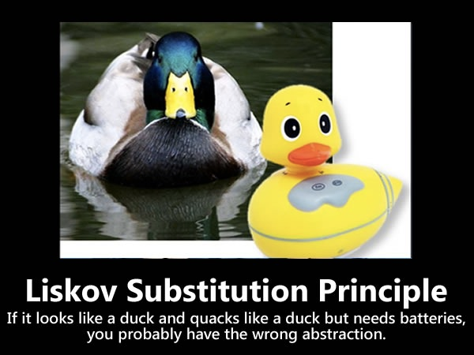

Slide 27
In class hierarchies, it should be possible to treat a specialized object as if it were a base class object.

Slide 28
Object lastReading() {
return readings.lastElement();
}

Slide 29
Encapsulate Downcast
Reading lastReading() {
return (Reading) readings.lastElement();
}
Notes:
A method returns an object that needs to be downcasted by its callers.
Move the downcast to within the method.

Slide 30
public void Filter(IFilter filter, object[] targets)
{
if (filter is StringValueFilter)
{
StringValueFilter strFilter = (StringValueFilter) filter;
// call a specific member on the StringValueFilter
}
}
Notes:
Your abstraction is leaky and needs to be refactored or eliminated. In the case above, everything should be accomplished through the IFilter interface.
You’ve violated Tell, Don’t Ask, which is another way of saying that you’re not properly encapsulating functionality. Encapsulation is important for a couple reasons. First, encapsulation makes code easier to use because there is less stuff necessary to know or do to make it work. Secondly, poor encapsulation can greatly increase duplication throughout your code base.

Slide 31
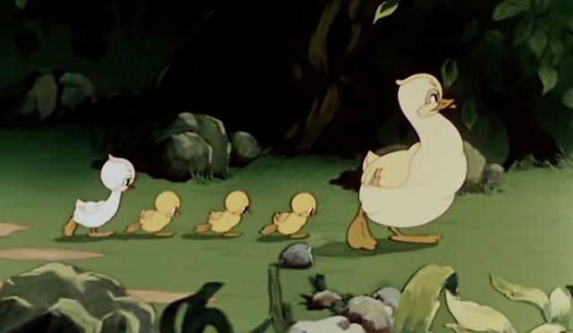
Downcast
Class Casting Is a Discriminating Anti-Pattern

Slide 32
a type cast which breaks the abstraction model; the abstraction may have to be refactored or eliminated.

Slide 33
Abandon downcasting
public void Filter(StringValueFilter filter, object[] targets)
{
// call a specific member on the StringValueFilter
}

Slide 34
interface Bird
{
void fly();
void buildNest();
void sing();
}
Notes:
Your abstraction is leaky and needs to be refactored or eliminated. In the case above, everything should be accomplished through the IFilter interface.
You’ve violated Tell, Don’t Ask, which is another way of saying that you’re not properly encapsulating functionality. Encapsulation is important for a couple reasons. First, encapsulation makes code easier to use because there is less stuff necessary to know or do to make it work. Secondly, poor encapsulation can greatly increase duplication throughout your code base.

Slide 35
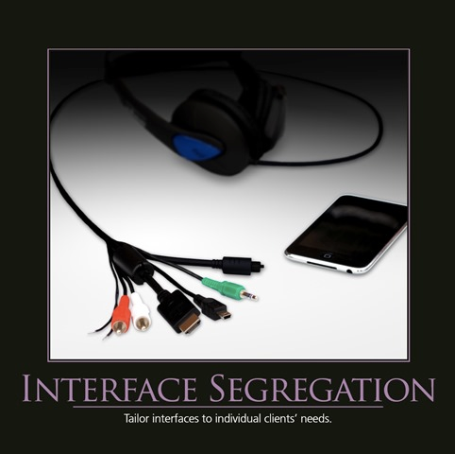

Slide 36
Clients should not be forced to depend upon interfaces that they don't use.

Slide 37
Segregate Interface
interface Bird
{
void eat();
}
interface FlyingBird extends Bird
{
void fly();
}
Notes:
Your abstraction is leaky and needs to be refactored or eliminated. In the case above, everything should be accomplished through the IFilter interface.
You’ve violated Tell, Don’t Ask, which is another way of saying that you’re not properly encapsulating functionality. Encapsulation is important for a couple reasons. First, encapsulation makes code easier to use because there is less stuff necessary to know or do to make it work. Secondly, poor encapsulation can greatly increase duplication throughout your code base.

Slide 38
class List
{
void Add(int item) {}
void Remove(int index) {}
int Get(int index) {}
}
class Stack extends List
{
void Push(int item) {}
void Pop() {}
int Peek() {}
}
Notes:
Your abstraction is leaky and needs to be refactored or eliminated. In the case above, everything should be accomplished through the IFilter interface.
You’ve violated Tell, Don’t Ask, which is another way of saying that you’re not properly encapsulating functionality. Encapsulation is important for a couple reasons. First, encapsulation makes code easier to use because there is less stuff necessary to know or do to make it work. Secondly, poor encapsulation can greatly increase duplication throughout your code base.

Slide 39
void DoJob(List list)
{
…
list.remove(3);
…
}
Notes:
Your abstraction is leaky and needs to be refactored or eliminated. In the case above, everything should be accomplished through the IFilter interface.
You’ve violated Tell, Don’t Ask, which is another way of saying that you’re not properly encapsulating functionality. Encapsulation is important for a couple reasons. First, encapsulation makes code easier to use because there is less stuff necessary to know or do to make it work. Secondly, poor encapsulation can greatly increase duplication throughout your code base.

Slide 40

Favour Composition over Inheritance

Slide 41
Inheritance is one of the most abused concepts

Slide 42
Abandon Inheritance
class List
{
void Add(int item) {}
void Remove(int index) {}
int Get(int index) {}
}
class Stack
{
List list = new List();
void Push(int item) {}
void Pop() {}
int Peek() {}
}
Notes:
Your abstraction is leaky and needs to be refactored or eliminated. In the case above, everything should be accomplished through the IFilter interface.
You’ve violated Tell, Don’t Ask, which is another way of saying that you’re not properly encapsulating functionality. Encapsulation is important for a couple reasons. First, encapsulation makes code easier to use because there is less stuff necessary to know or do to make it work. Secondly, poor encapsulation can greatly increase duplication throughout your code base.

Slide 43
class Image
{
static Image get(byte[] data)
{
if(…)
return new Jpeg(data);
if(…)
return new Gif(data);
}
}
class Gif extends Image {}
class Jpeg extends Image {}
Notes:
Your abstraction is leaky and needs to be refactored or eliminated. In the case above, everything should be accomplished through the IFilter interface.
You’ve violated Tell, Don’t Ask, which is another way of saying that you’re not properly encapsulating functionality. Encapsulation is important for a couple reasons. First, encapsulation makes code easier to use because there is less stuff necessary to know or do to make it work. Secondly, poor encapsulation can greatly increase duplication throughout your code base.

Slide 44
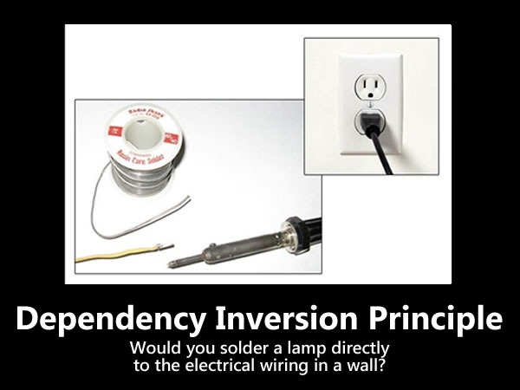

Slide 45
Abstractions should not depend on details. Details should depend on abstractions

Slide 46
DIP is also referred as "The Hollywood principle" , which states don't call us , we will call you

Slide 47
Parent should not know Child
class Image{}
class Gif extends Image {}
class Jpeg extends Image {}
class ImageFactory
{
static Image get(byte[] data)
{
if(…)
return new Jpeg(data);
if(…)
return new Gif(data);
}
}
Notes:
Your abstraction is leaky and needs to be refactored or eliminated. In the case above, everything should be accomplished through the IFilter interface.
You’ve violated Tell, Don’t Ask, which is another way of saying that you’re not properly encapsulating functionality. Encapsulation is important for a couple reasons. First, encapsulation makes code easier to use because there is less stuff necessary to know or do to make it work. Secondly, poor encapsulation can greatly increase duplication throughout your code base.

Slide 48
class SurveyData
{
String path; //save the data to this file.
boolean hidden; //should the file be hidden?
void setSavePath(int t)
{
if (t == 0)
{ //raw data.
path = "c:/application/data/raw.dat";
hidden = true;
}
else if (t == 1)
{ //cleaned up data.
path = "c:/application/data/cleanedUp.dat";
hidden = true;
}
else if (t == 2)
{ //processed data.
path = "c:/application/data/processed.dat";
hidden = true;
}
else if (t == 3)
{ //data ready for publication.
path = "c:/application/data/publication.dat";
hidden = false;
}
}
}

Slide 49
Functions without if’s are easier to read
Functions without if’s are easier to test
Polymorphic systems are easier to maintain
Notes:
No cc

Slide 50
Eliminate Type Code
class SurveyDataType
{
String baseFileName;
boolean hideDataFile;
SurveyDataType(String baseFileName, boolean hideDataFile)
{
this.baseFileName = baseFileName;
this.hideDataFile = hideDataFile;
}
String getSavePath()
{
return "c:/application/data/" + baseFileName + ".dat";
}
static SurveyDataType rawDataType =new SurveyDataType("raw", true);
static SurveyDataType cleanedUpDataType =new SurveyDataType("cleanedUp", true);
static SurveyDataType processedDataType =new SurveyDataType("processed", true);
static SurveyDataType publicationDataType =new SurveyDataType("publication", false);
}
Notes:
//The data folder is duplicated.
//The folder "c:/application/data" is duplicated. The ".dat" is duplicated.
//The setting of hidden is duplicated.
//Consider removing the ifthen-else-if.
//The type code should be eliminated.
//Consider renaming some names.

Slide 51
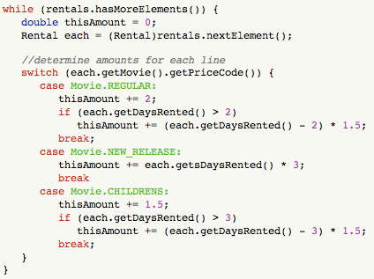

Slide 52
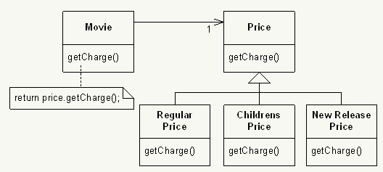

Slide 53
class Currency
{
final public int USD = 0;
final public int RMB = 1;
final public int ESCUDO = 2; //Portuguese currency
private int currencyCode;
public Currency(int currencyCode)
{
this.currencyCode = currencyCode;
}
public String format(int amount)
{
switch (currencyCode)
{
case USD:
//return something like $1,200
case RMB:
//return something like RMB1,200
case ESCUDO:
//return something like $1.200
}
}
}

Slide 54
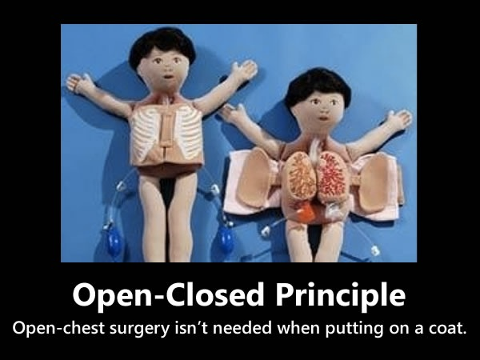

Slide 55
Software entities (classes, modules, functions, etc.) should be open for extension but closed for modification.

Slide 56
Avoid Conditional Code
interface Currency {
public String format(int amount);
}
class USDCurrency implements Currency {
public String format(int amount) {
//return something like $1,200
}
}
class RMBCurrency implements Currency {
public String format(int amount) {
//return something like RMB1,200
}
}
class ESCUDOCurrency implements Currency {
public String format(int amount) {
//return something like $1.200
}
}

Slide 57
Problem
Client
AccountBO
AccountBO obj = new ? ;
TransactionHandler.Withdraw(5000);
SavingBO
CurrentBO
TransactionHandler
+ Withdraw(obj : AccountBO, amt: double)
If( type(obj) == type(SavingBO))
{
……… SA withdraw logic ………….
}
If( type(obj) == type(CurrentBO))
{
……… CA withdraw logic ………….
}

Slide 58
Abandon RTTI
Client
AccountBO
+ Withdraw(amt) {a}
AccountBO obj = new ? ;
obj.Withdraw(5000);
SavingBO
CurrentBO
+ Withdraw(amt)
+ Withdraw(amt)
…… SA withdraw logic …….
…… CA withdraw logic ……

Slide 59
Public void RegisterPatient(Patient p)
{
try
{
if(Context.User.IsInRole(“CareTake”))
{
SendMail(p.Email, p.Name, p.DiseaseType, p.Country, template);
PatientRepository r = new PatientRepository();
r.Add(p);
if(p.Age > 50)
…..
if(p.AccountType== “ManagedCare”)
…..
}
}catch(Exception ex)
{
ExceptionHandler.Handle(ex);
}
}

Slide 61
If the application is not changing in ways that cause the two responsibilities to change at different times, there is no need to separate them.

Slide 62
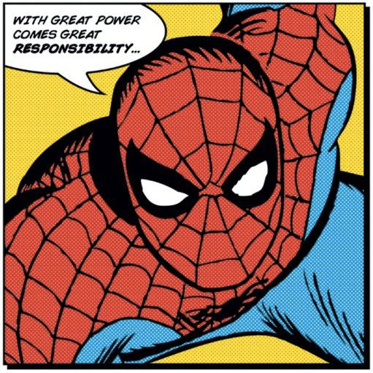
Weighted methods of a class (WMC)
Functions
Max 12 behaviour
does not include getter,setter and private methods
Average 5 behaviour
Notes:
Same Goal: the code should speak for itself
The reader shouldn't have to look at the function definition nor to its usages

Slide 63
Public void RegisterPatient(Patient p)
{
try
{
if(Context.User.IsInRole(“CareTake”))
{
SendMail(p.Email, p.Name, p.DiseaseType, p.Country, template);
PatientRepository r = new PatientRepository();
r.Add(p);
if(p.Age > 50)
…..
if(p.AccountType== “ManagedCare”)
…..
}
}catch(Exception ex)
{
ExceptionHandler.Handle(ex);
}
}

Slide 64
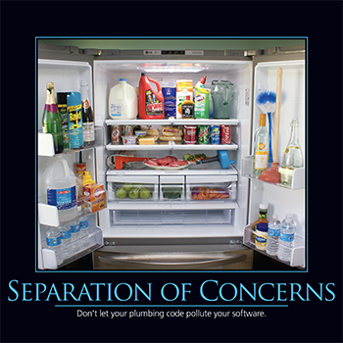

Slide 65
avoid pollution of the domain logic with infrastructure stuff

Slide 66
Problem
JobScheduler
if(jobId == 1)
…. Logic 1 …..
else if(jobId == 2)
…. Logic 2 …..
else if(jobId == 3)
…. Logic 3 …..
else
…. Logic 4 …..
+ execute(jobId: int)
Notes:
1. No transaction fee state — As long as the account balance remains greater
than the minimum balance, no transaction fee will be charged for any
deposit or withdrawal transaction. The example application has the minimum
balance as $2,000.
2. Transaction fee state — An account is considered to be in the transaction
fee state when the account balance is positive but below the minimum
balance. A transaction fee will be charged for any deposit or withdrawal
transaction in this state. The example application has the transaction fee
in this state as $2.
3. Overdrawn state — This is the state of the account when an account balance
is negative but within the overdraft limit. A transaction fee will be charged
for any deposit or withdrawal transactions in this state. The example
application has the transaction fee in this state as $5 and the overdraft limit
is maintained as $1,000.

Slide 67

God Class
Also known as Blob / Kitchen Sink Class

Slide 68
Procedural-style design leads to one object with a lion’s share of the responsibilities, while most other objects only hold data or execute simple processes.

Slide 69
use lookup
Cmd
+ execute()
Cmd1
Cmd2
Cmd3
JobScheduler
lookup
+ execute(jobId: int)
Cmd cmd = lookup(id);
cmd. Execute();

Slide 70

Fear of Adding Classes
Sparse is better than dense. - Tim Peters, The Zen of Python

Slide 71
Belief that more classes necessarily make designs more complicated, leading to a fear of adding more classes or breaking large classes into several smaller classes.

Slide 72
class Account {}
class SavingAccount extends Account {}
class CurrentAccount extends Account {}
class OverDraftAccount extends Account {}
class Transaction
{
void WithDraw(SavingAccount a,double amount) {}
void WithDraw(CurrentAccount a,double amount) {}
void WithDraw(OverDraftAccount a,double amount) {}
}

Slide 73
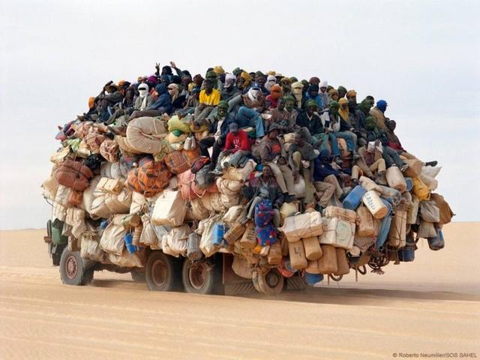
Overloading UDT

Slide 74
Account a = new CurrentAccount();
Transaction t = new Transaction();
t.Withdraw(a,1000);

Slide 75
Abandon overloading UDT
class Account
{
abstract withDraw(amount);
}
class SavingAccount extends Account {}
class CurrentAccount extends Account {}
class OverDraftAccount extends Account {}

Slide 76
Design By Contract
Preconditions
A method imposes on the client a set of conditions that must be met in order for the method to be invoked successfully
parameters validation.
Postconditions
a set of properties are guaranteed by the method immediately after the execution
a return value that can only be positive
Invariants
A set of properties on the class are assumed to hold before the method starts and are guaranteed to hold after the method completes
a field of the class that may not be negative, for example).
Notes:
Design by Contract was first introduced by Bertrand Meyer, creator of the Eiffel programming language, in his seminal book Object-oriented Software Construction. In a nutshell, DBC is based on the following principles:
preconditions: a method imposes on the client a set of conditions that must be met in order for the method to be invoked successfully (think about parameters validation).
postconditions: a set of properties are guaranteed by the method immediately after the execution (think about a return value that can only be positive, for example).
invariants: a set of properties on the class are assumed to hold before the method starts and are guaranteed to hold after the method completes (think about a field of the class that may not be negative, for example).
The main purpose of contracts is to help us build better software by organizing the communication between software elements through specifying, as precisely as possible, the mutual obligations and benefits that are involved in those communications. [...] relying on these notions—that is to say, making sure when you write software that don’t just write the implementation, but also write the more abstract properties underlying the implementation in the form of contracts—provides a greatly added software development experience in several respects. It helps ensure correctness in the first place, helps debugging, helps testing, helps ensure inheritance is properly handled, helps managers, provides a quite effective form of documentation, and a few others.
Up to now, only a few languages supported DBC natively, and C# was not one of those. With .NET 4.0 Microsoft fills this gap with Code Contracts. It’s possible to download Code Contracts for Visual Studio 2008 for the Standard Edition and the Team System edition.

Slide 77
using System.Diagnostics.Contracts; // ... public void SampleMethod(Item[] aCollection, ref Decimal total) { // Pre-Conditions CodeContract.Requires(total >=0); CodeContract.Requires(aCollection!= null); // ... // Postconditions CodeContract.Ensures(total >= CodeContract.OldValue(total)); }

Slide 78
class Student{
List<Course> courses;
}
class Course {
List<Student> students;
}

Slide 79

Tight Coupling
Tightly coupled modules are difficult to reuse, and also hard to test.

Slide 80
If making a change in one module in your application requires you to change another module, then coupling exists.

Slide 81
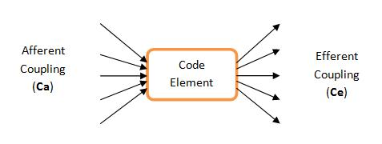
Efferent Coupling < 7
Notes:
the Ca for a code element is the number of code elements that use it and the Ce is the number of code elements that it uses.

Slide 82
Abandon bidirectional/cyclic coupling
class Student{}
class Course {}
class Register
{
List<Course> courses;
List<Student> students;
map<int,Course> studentCourseMap;
map<int,Student> courseStudentMap;
}

Slide 83
/** * Validates the order and returns the order ID **/ private String validate(Order order)
{ String custID = order.getCustomerID(); String itemID = order.getItemID(); int qty = order.getQty(); double price = order.getPrice(); if (custID != null && itemID != null && !custID.equals("") && !itemID.equals("") && qty > 0 && price > 0.0) { return …; } return null; }
Notes:
This bad example comes from Apache CXF Web Service Development book by Naveen Balani and Rajeev Hathi.

Slide 84


Indecent Exposure
Beware of classes that unnecessarily expose their internals.
Notes:
Aggressively refactor classes to minimize their public surface. You should have a compelling reason for every item you make public. If you don't, hide it.

Slide 85
Tell Don't Ask
private String getOrderId(Order order)
{ if (order.isValid())
{ return "ORD1234"; } return null; }

Slide 86
Tell Don’t Ask
if(getStateOfSomething())
doThis();
else
doThat();
V/S
object.doSomethingForMe();

Slide 87
“Tell Don’t Ask” principle encourages you to tell an object to do something rather than rip data out of an object to do it in client code.

Slide 88
Paperboy
+ CollectPayments()
Customer
Wallet
decimal payment = 2m;
foreach (Customer customer in Customers)
{
if (customer.Wallet.Money >= payment)
{
customer.Wallet.Money -= payment;
fundsCollected += payment;
}
}

Slide 89
dog.Legs[0].MoveForward();
dog.Legs[1].MoveForward();
dog.Legs[2].MoveForward();
dog.Legs[3].MoveForward();
v/s
dog.Move();

Slide 90
Principle of least knowledge (LOD)
Any method of an object should only call methods belonging to:
itself
any composite objects
any parameters that were passed in to the method
any objects it created

Slide 91

Train Wreck?
Methods belonging to objects that were returned from some other call.
my_television.front_panel.switches.power.on();
v/s
my_television.power_up();
Talk only to your neighbors, not with their neighbors.

Slide 92

Law of Demeter violation is like a haystack where the code is desperately trying to locate the needle.

Slide 93
Law of Demeter
Your method can call other methods in its class directly
Your method can call methods on its own fields directly (but not on the fields' fields)
When your method takes parameters, your method can call methods on those parameters directly.
When your method creates local objects, that method can call methods on the local objects.
One should not call methods on a global object (but it can be passed as a parameter ?)
One should not have a chain of messages a.getB().getC().doSomething() in some class other than a's class.
Notes:
Only talk to your immediate friends." E.g. one never calls a method on an object you got from another call nor on a global object. This helps a lot later when you ReFactor the code.
public class StudentPrinter{ ... public String printStudent(Student student){ ... String course = student.getCourse(i).getName(); // violation } }

Slide 94
File
TextFile
BinaryFile
XmlTextFile
CsvTextFile
JsonTextFile
XmlBinaryFile
JsonBinaryFile

Slide 95
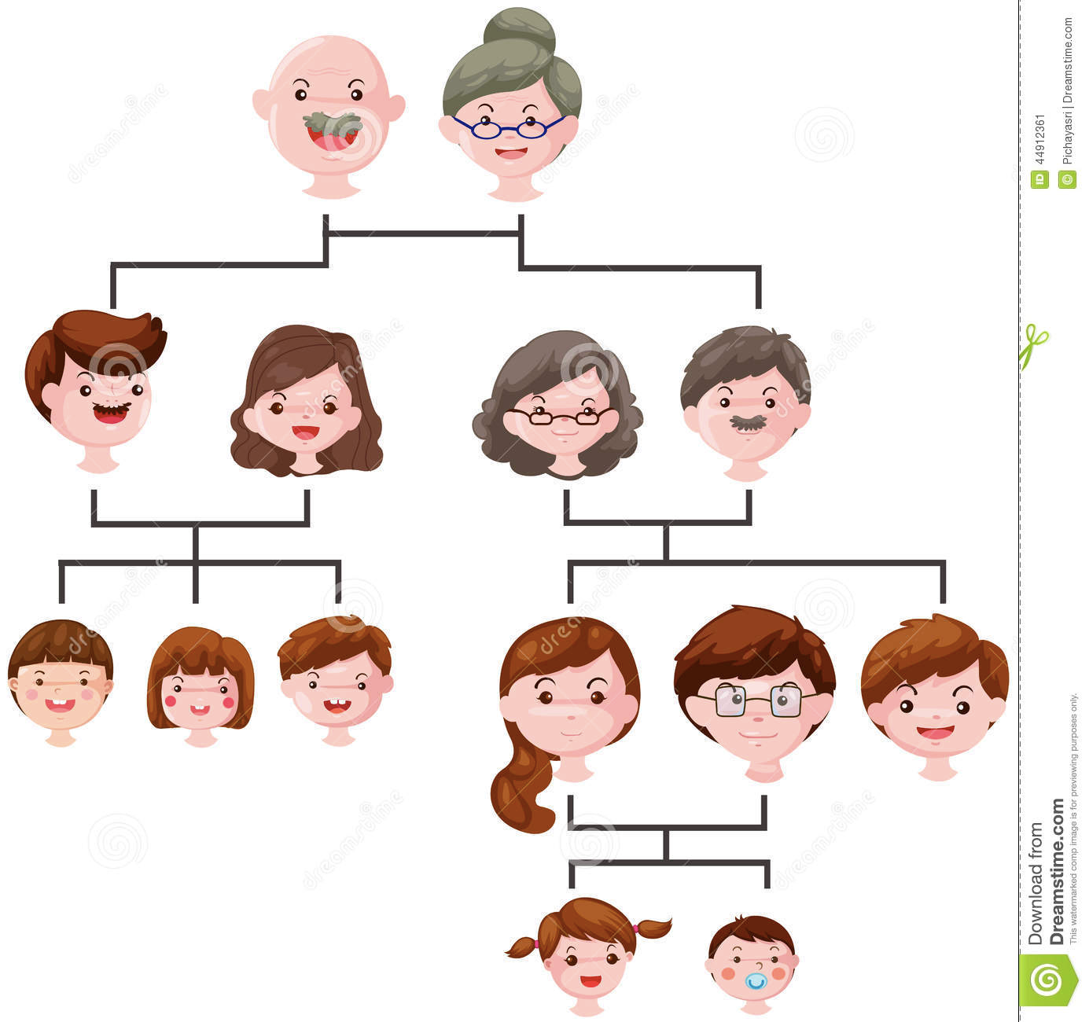
Class Hierarchy
< 4

Slide 96
AccountBO
TypeBO
SavingBO
CurrentBO
NPCurrentBO
PrivCurrentBO

Slide 97
Unit Testing Problem
Monitor
SparkPlug
+ Monitor(ctx: Context)
this.sparkPlug = context. getCar().getEngine(). getPiston().getSparkPlug();
Notes:
Now imagine how hard will it be to write a test for this class:

Slide 98
no principle is a law, and all principles should be used when and where they are helpful.
Notes:
We prefer to use the [term] Principle of Least Knowledge
I tend to think of it as the "suggestion of Demeter", because sometimes there are good reasons to "violate" it, and I agree with you that extension methods are a good example.
Extension methods are a form of method chaining, and while method chains do have a bunch of 'dots' in them, they're not the same as the 'dots' in LoD violations. Counting dots isn't the point.

Slide 99


Slide 100
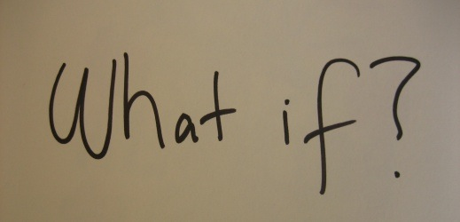
YAGNI (You ain’t gonna need it)
"Always implement things when you actually need them, never when you just foresee that you need them.” – Ron Jeffries
The need for combining it with the supporting practices, rather than using it standalone

Slide 101
Solve tomorrows problem tomorrow,
Good for now Design
Notes:
They apply it quite broadly to include "database schemas, test plans, the build system, even documentation."[

Slide 102
Simplicity is the ultimate sophistication
Leonardo da Vinci

Slide 103
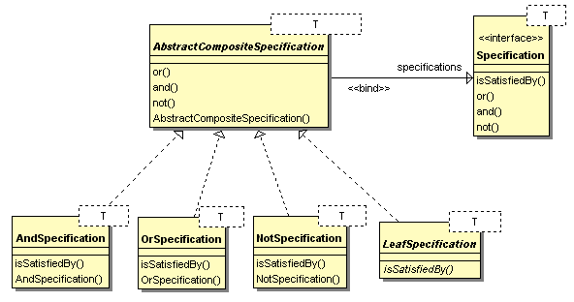

Slide 104
var OverDue = new OverDueSpecification();
var NoticeSent = new NoticeSentSpecification();
var InCollection = new InCollectionSpecification();
// example of specification pattern logic chaining
var SendToCollection = OverDue.And(NoticeSent).And(InCollection.Not());
var InvoiceCollection = Service.GetInvoices();
foreach (var currentInvoice in InvoiceCollection) {
if (SendToCollection.IsSatisfiedBy(currentInvoice)) {
currentInvoice.SendToCollection();
}
}

